Slide 1
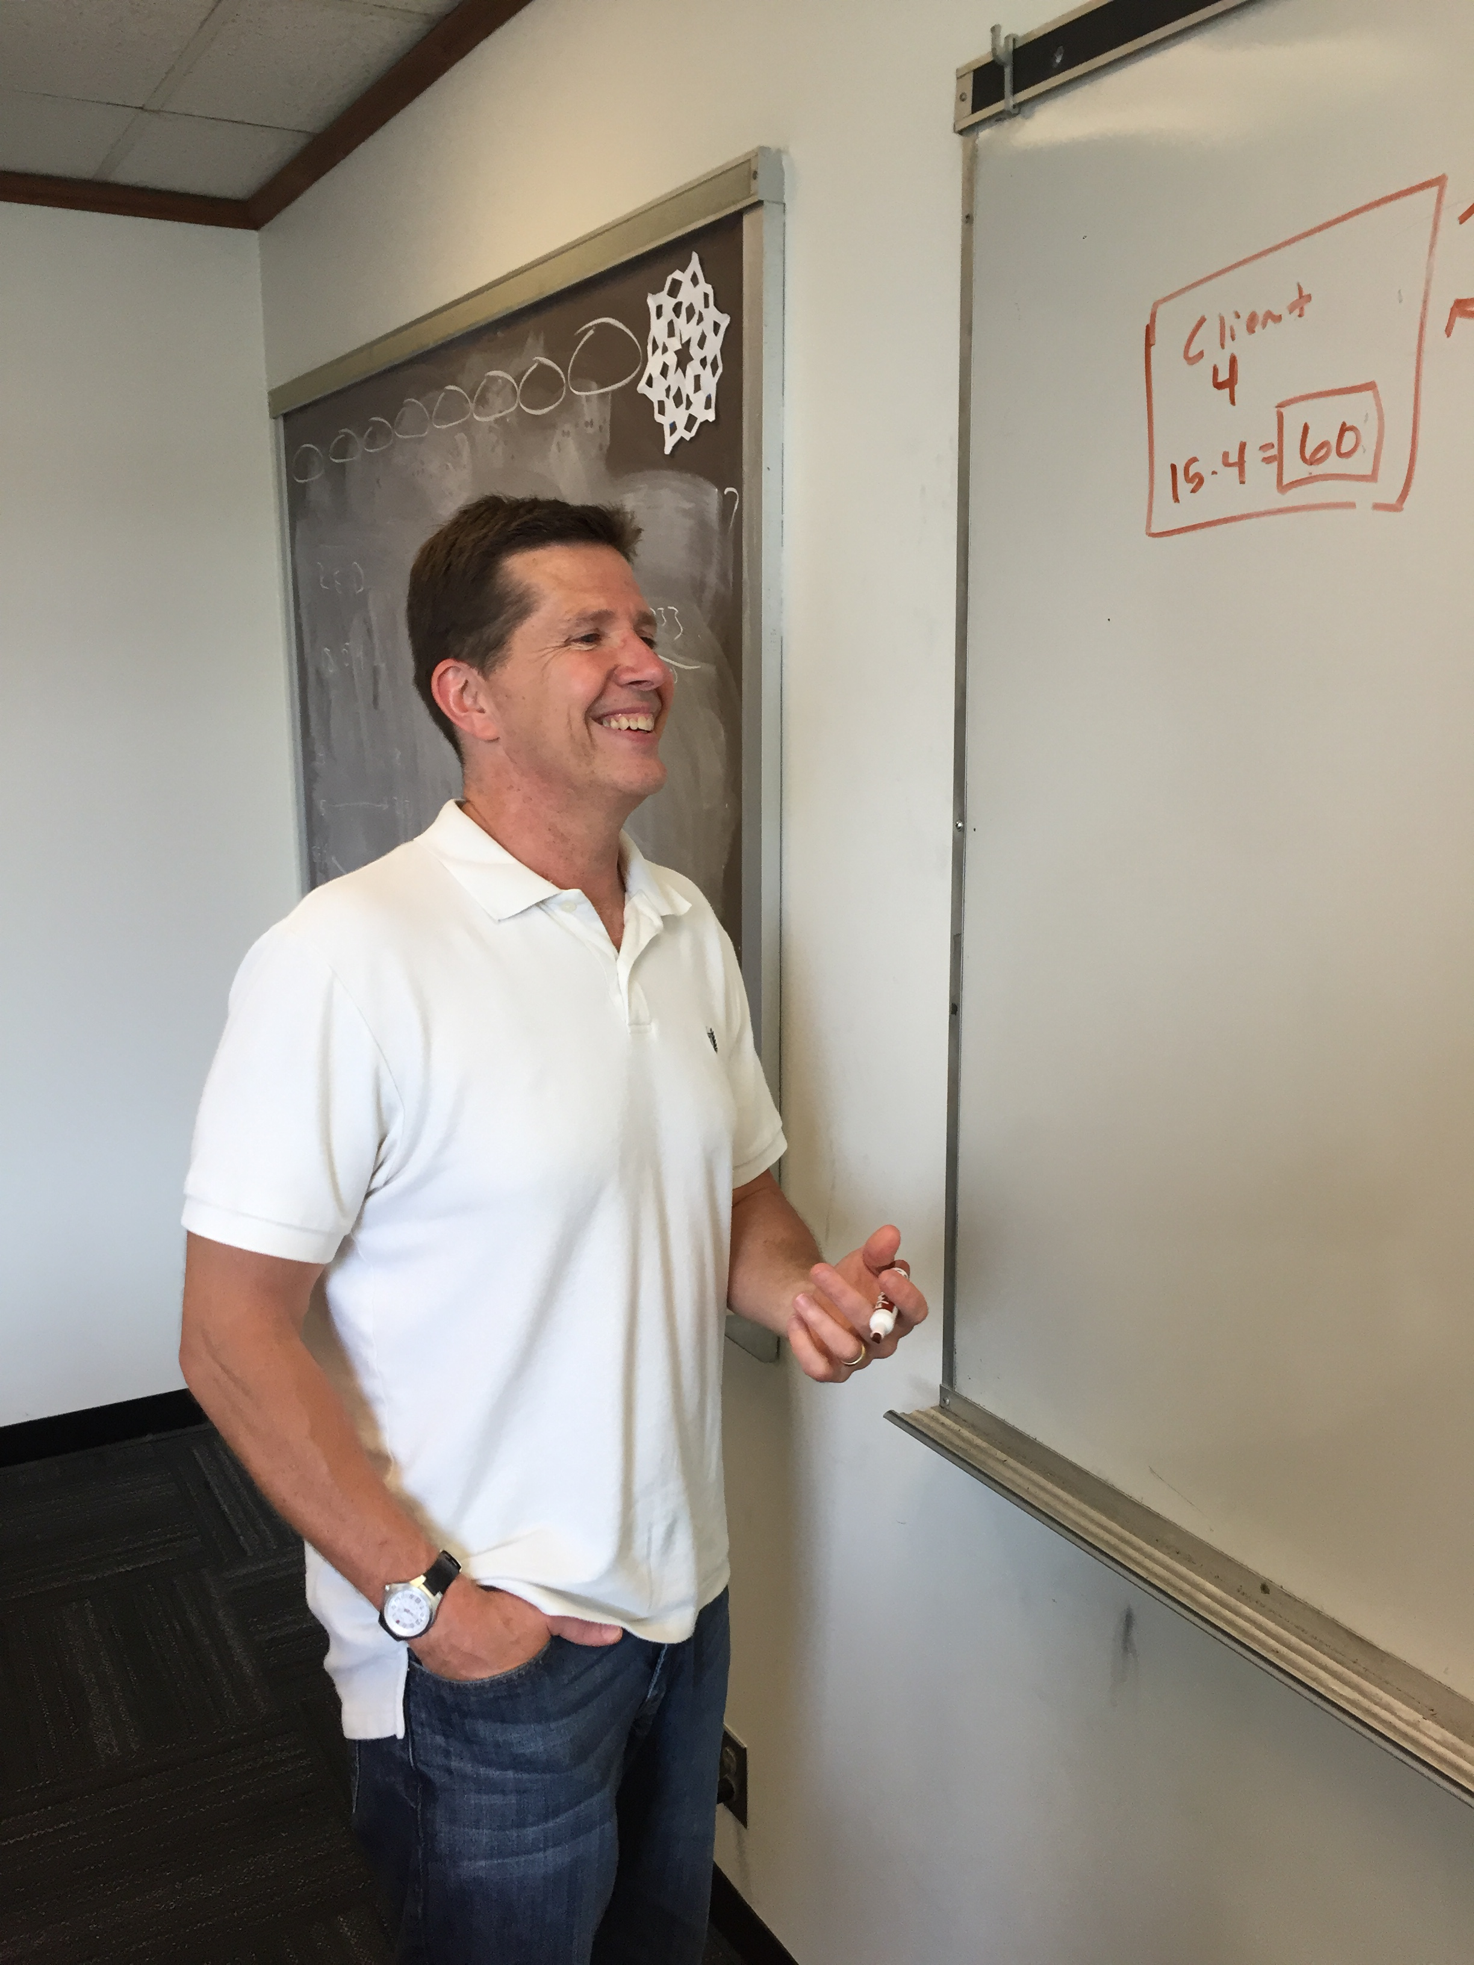
Cyberspace
Attack & Defense
Sam Mizener and James Prugh

Slide 2
Table of Contents
Abstract & Introduction
Goals & Objectives
Unit Topics
Security - Tools of Encryption
Safety - Implementing Tools
Notes:
Talking Points:
Security - Integrity, Availability, Authentication, Confidentiality
Safety - Vulnerabilities in languages, operating systems, social engineering attacks

Slide 3
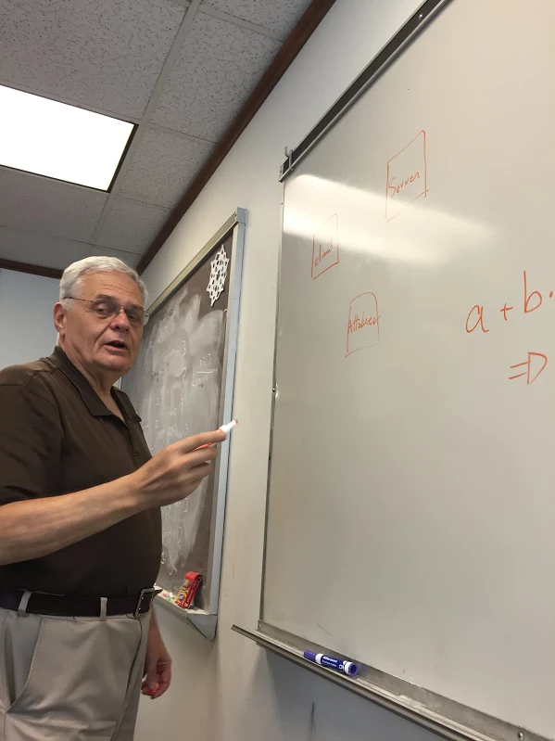
Abstract
Society is threatened by cyberspace attackers
Security is essential for the protection of sensitive data
Economics, Intellectual Property, National Security, Currency
Tools have been developed to ensure security
Several of these tools have vulnerabilities
Exploitable by attackers
Security is threatened by new vulnerabilities
Cybersecurity is ongoing process
Notes:
Talking Points: The vulnerabilities are getting more and more sophisticated with programmers continuing to put vulnerabilities into codes. Cybersecurity is lagging behind and NEEDS to catch up.

Slide 4
Introduction
There is a growing need for internet security. Both the sending and storage of data is highly subject to attack. Through number theory, several tools have been developed to protect sensitive data such as financial information, intellectual property, and personal passwords. Since some of these tools contain vulnerabilities, cyber security is an ongoing process.

Slide 6
Need → opportunity
Great need for cyber professionals
Computer Science, Information Technology, Mathematics
Rewarding opportunities available to students
Number Theory builds foundation
Notes:
“The Pentagon is in the process of rapidly increasing its cyber team” “US #1 in Cybersecurity rankings – GCI” “Trump says we are obsolete…

Slide 7
Goals & Objectives
Foster student interest in Computer Science and Mathematics
Teach
Number Theory
Encryption
Apply
Internet Security
Vulnerabililties

Slide 8
Research Training Received
Lessons in number theory
Algorithms for finding roots and divisors
Modular arithmetic
Diffie - Hellman algorithm
Fermat’s Little theorem
RSA
Notes:
Talking Points: Permutations

Slide 9
The role of number theory in internet security?
Integrity
One way hash functions - SHA3
Confidentiality
Encryption - AES
Authentication
Public Key - RSA

Slide 10
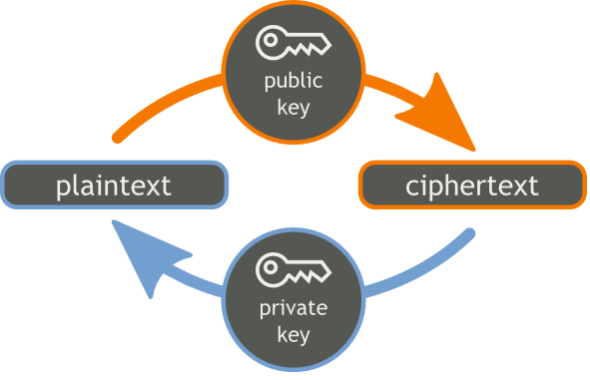
Why is number theory important for internet security?
Symmetric Encryption
Modular arithmetic is used to find a shared secret between parties
Diffie - Hellman Algorithm
One - Way Functions
Easy to put together, hard to take apart
RSA

Slide 11
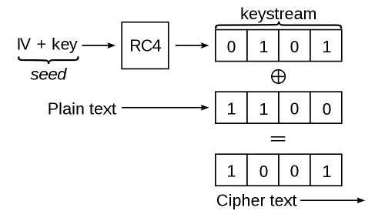
Tools that are used in encryption
Binary encoding
Operators
Encryption techniques
Substitution and Transformation Cipher
RSA (Rivest, Shamir, Aldeman)

Slide 12
Unit Topics
Number Theory and Cybersecurity
Lessons in Number Theory
Challenge: Design a secure method to send a message to another party.

Slide 13
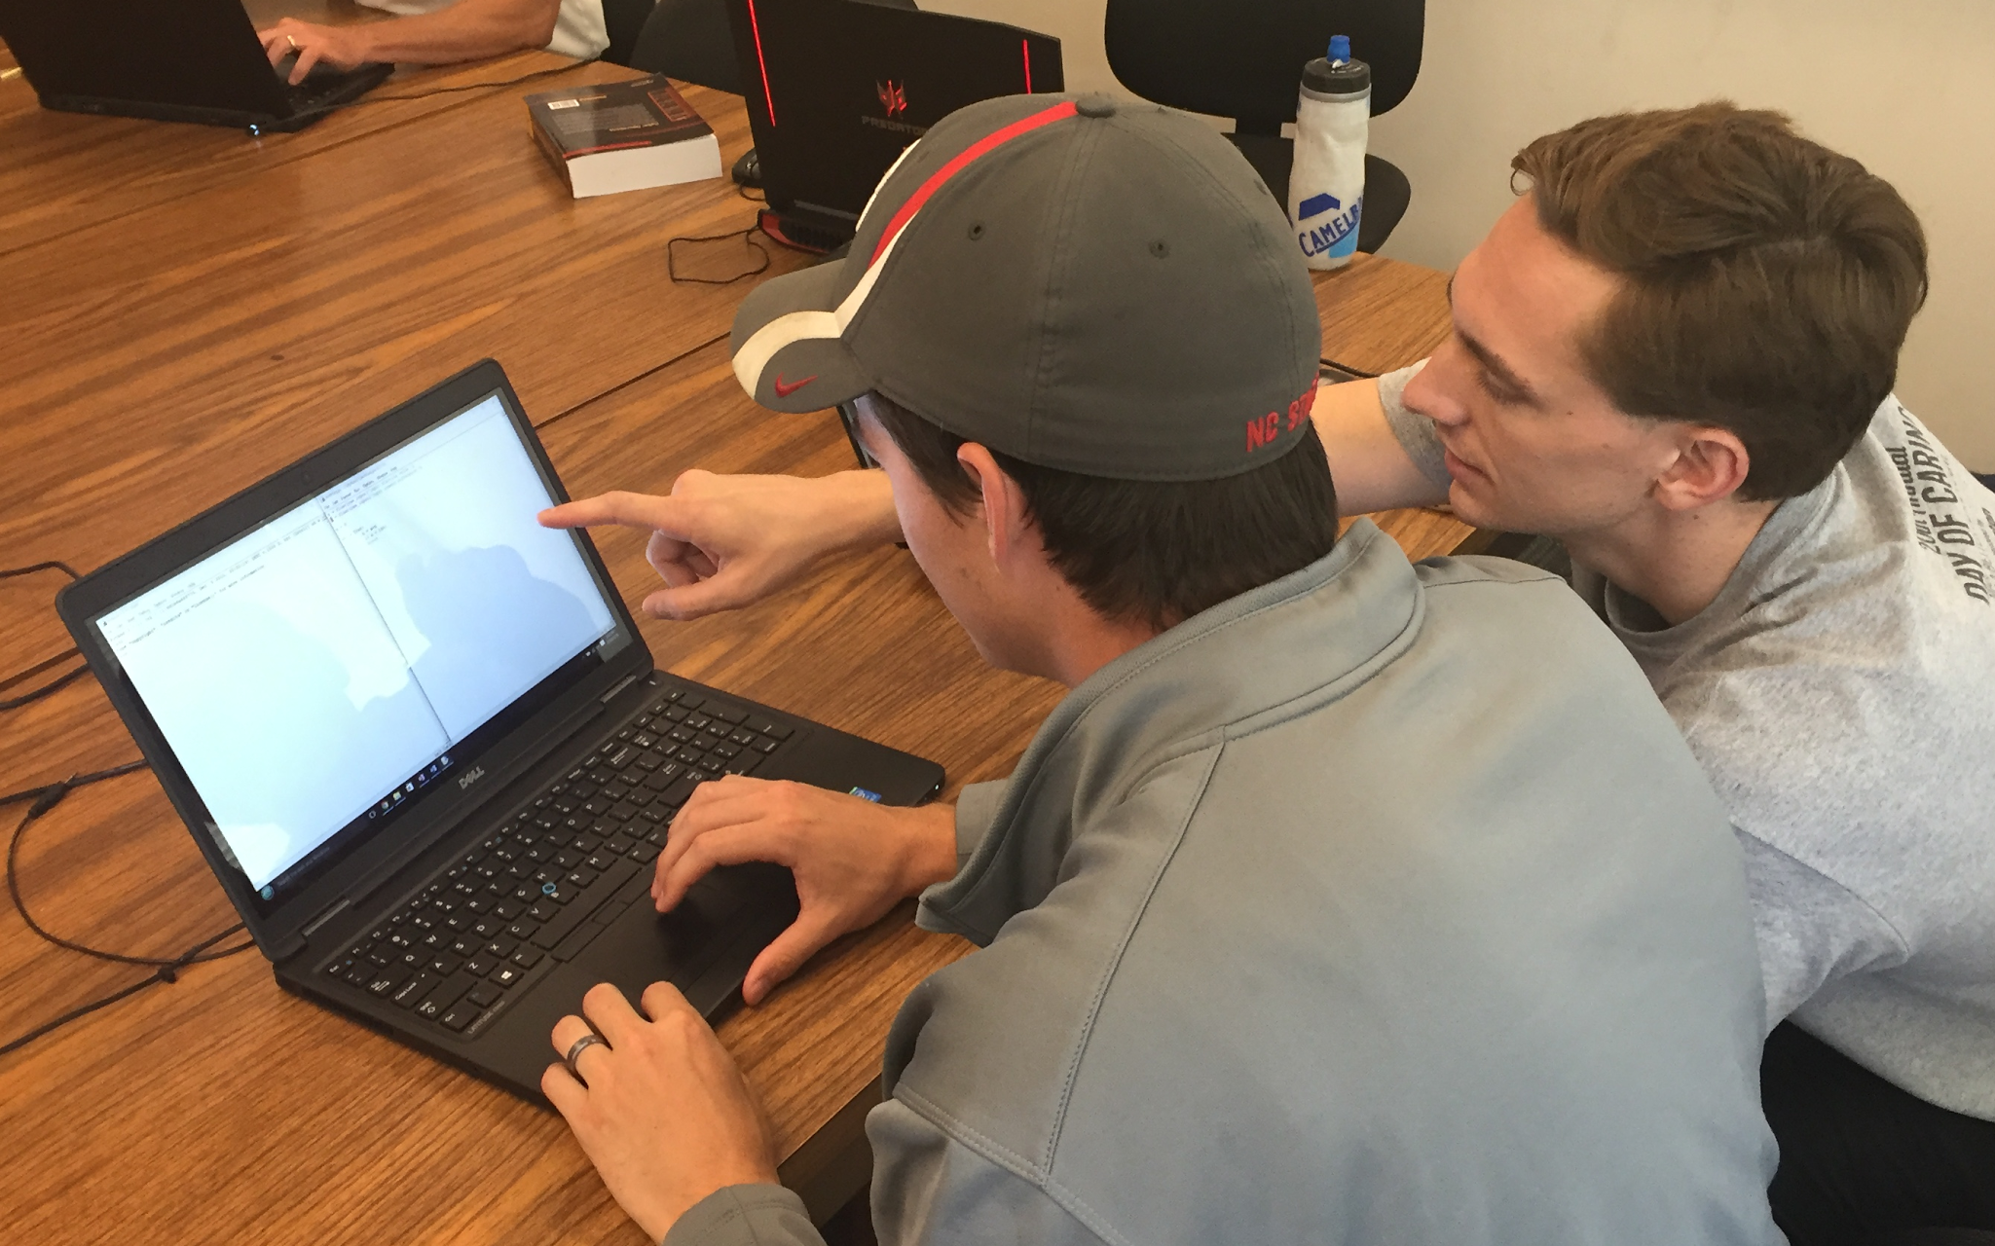
Research Training Received
Learning Python
Writing code
Error Messages and Exceptions
Handshake Protocol Vulnerabilities
Single Handshake
Mutual Authentication
Diffie-Hellman Exchange
Timestamp

Slide 14
Computer Programming
Vulnerabilities have increased due to unsafe coding
Vulnerabilities used to acquire/control information
Jeep Example
Heartbleed
Cyberattacks used offensively
Stuxnet
Russian Pipeline
Notes:
Talking Points: Acquire information, steal resources, “hack-tivists”

Slide 15
Unit Topics
Safety - Programming and Vulnerabilities
Importance of Cybersecurity
Research Applications, Career Awareness, Societal Impacts
Challenge: Adapt a client messaging program that is impervious to attacks.
“Game of Codes”

Slide 16
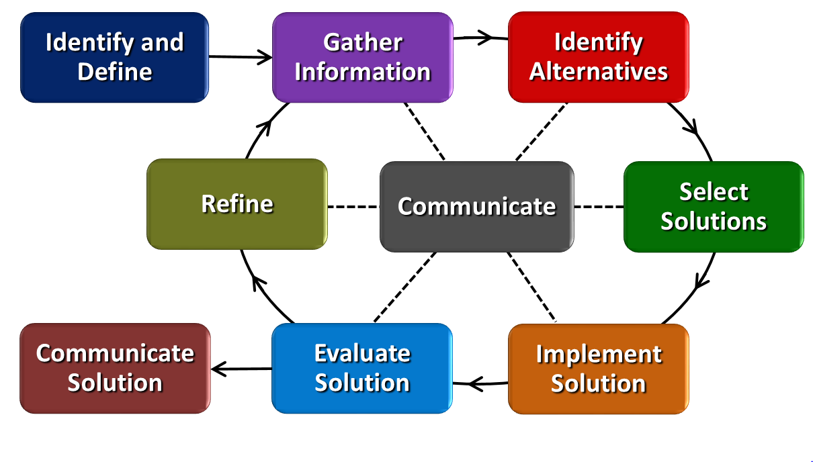
Program Development
Programmers write and rewrite codes
Necessity of having colleagues test codes
Possibility of “un-hackable” code needs iterations

Slide 17
RET is funded by the National Science Foundation, grant #EEC-1404766

